Slide 1
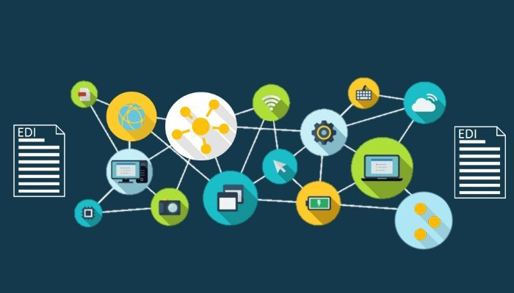
VALUE ADDED NETWORK

Slide 2

MEMBERS
ABHAY MISTRY
ABHISHEK PATIL
ARAV
ASHVANI KUMAR
BECHULAL GUPTA
PRATHAMESH POTE
RAHUL SHAH
ROHIT GHADGE
SATYENDRA GUPTA
SHIVANG VYAS
45
62
146
145
18
65
78
12
22
101

Slide 3

INTRODUCTION TO VAN

Slide 4
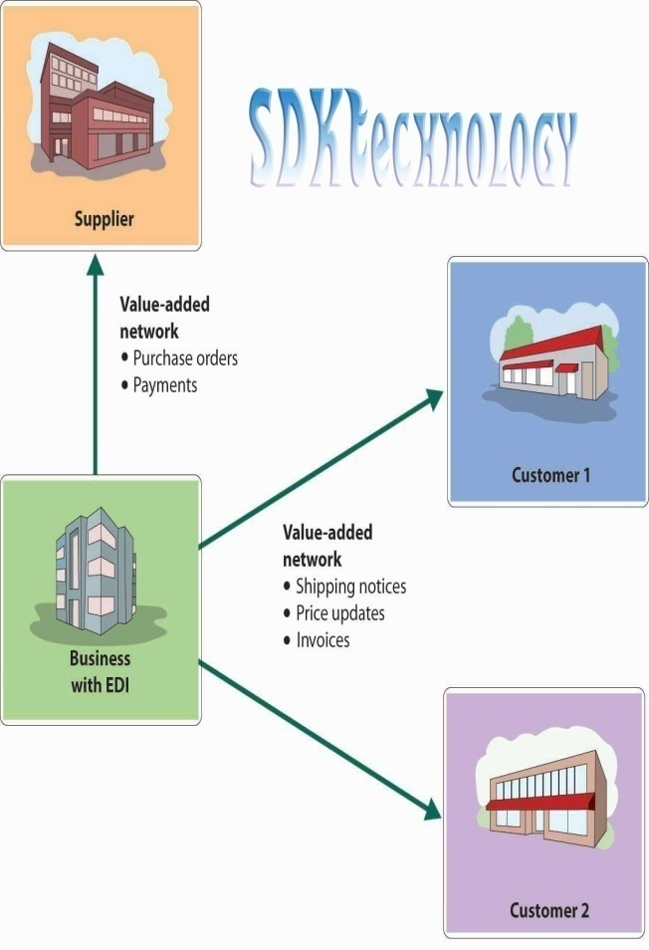
A value-added network (VAN) is a private, hosted service that provides companies with a secure way to send and share data with its counterparties.Value-added networks were a common way to facilitate electronic data interchange (EDI) between companies. As the Internet created competition for this service with the advent of secure email, VANs responded by expanding their service offerings to include things like message encryption, secure email, and management reporting.
A value-added network simplifies the communications process by reducing the number of parties with which a company needs to communicate. The VAN accomplishes this by acting as an intermediary between business partners that share standards-based or proprietary data. VANs are set up with audit capabilities so that the data being exchanged is formatted correctly and validated before it is transferred to the next party. VANs are sometimes referred to as added-value networks or turnkey communications lines.

Slide 5
Value-added networks are generally used by large companies for efficient supply chain managment with their suppliers, or by industry consortiums or telecommunications companies
VANs usually operate in a mailbox setting, wherein a company sends a transaction to a VAN, and the VAN places it in the receiver's mailbox. The receiver contacts the VAN and picks up the transaction, and then sends a transaction of its own.
The large-scale allocation of network services by private companies was in conflict with state-controlled telecommunications sector. To be able to gain a license for telecommunication service provision to customers, a private business had to "add value" to the communications line in order to be a distinguishable service. Therefore, the notion of "value-added network services" was established to allow for operation of such private businesses as an exemption from state control.

Slide 6

What is a ‘Value Added Network’ aka ‘VAN’?

Slide 7
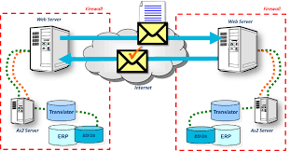
In today's world there are various issues related to privacy protection, due to which exchanging critical/sensitive information via internet is risky. Hence ‘VAN’ was introduced. 1) ‘VAN’ is a private, hosted service that provides companies with a secure way to exchange data between its counterparties. 2) Value-added networks were a common way to facilitate electronic data interchange(EDI) between companies.

Slide 8
3) A ‘VAN’ simplifies the communications process by reducing the number of parties with which a company needs to communicate. 4) But how does ‘VAN’ accomplish this feat? They do it by acting as an intermediary between business partners that share standard-based or proprietary data. 5) ‘VAN” is similar to an email, except that it is used for standardized structured data rather than unstructured text. 6)’VAN’s are considerably less used these days and are on a gradual decline due to the flourishing of the internet.

Slide 9
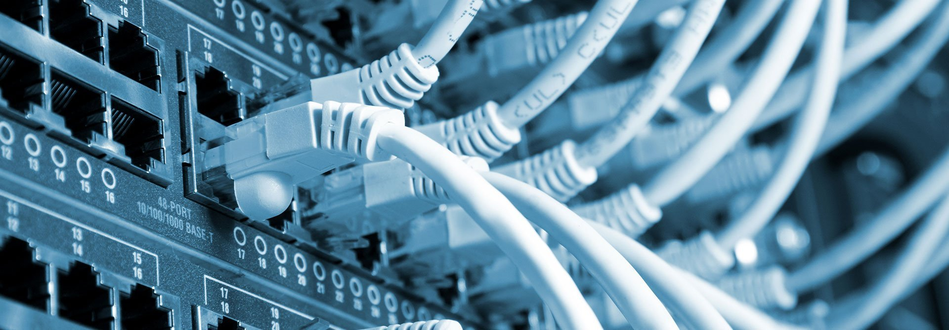
Types of VAN

Slide 10
Three types of Value Added Network, based on how the computers in the network are connected:
One to One
One to Many
Many to Many

Slide 11
One to One
The one-to-one network is a connection between two businesses exchanging data.

Slide 12
One to Many
A single business connected to multiple other businesses, e.g., a major retailer connected to its different suppliers.

Slide 13
Many to Many
Multiple businesses connected to one another. This is the most common type of network used in the financial markets since there are many market participants connected to each other via a single venue.

Slide 14
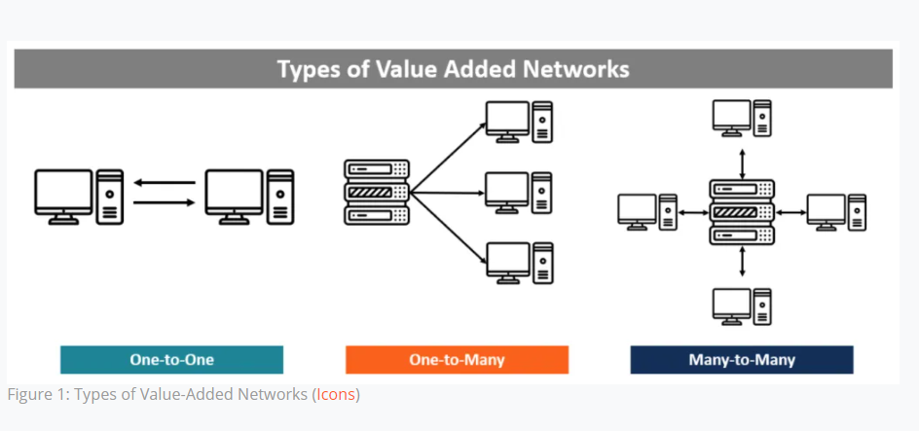

Slide 15
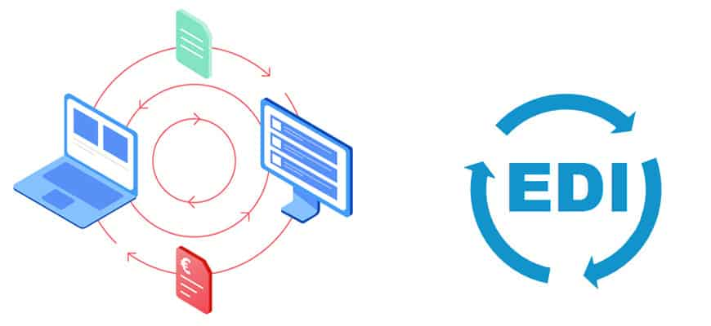
Components of Value Added Network (VAN)

Slide 16
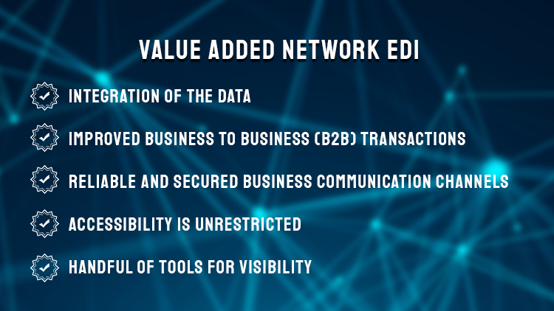
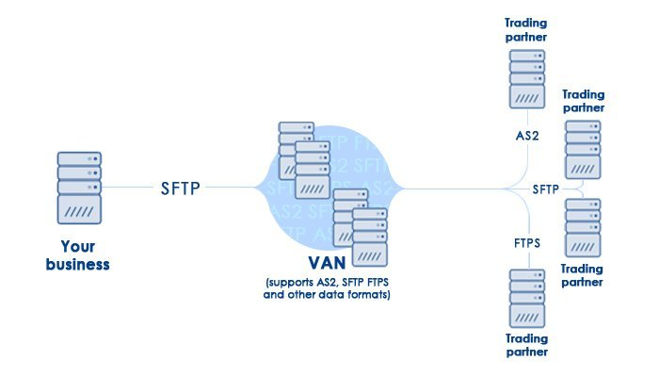
Components of value added network EDI
An EDI VAN (Value Added Network) offers a B2B (business to business)network of electronic communications, a network which includes an array of 'value added' services, as well as facilitated communication protocols that otherwise would not be available when going through the Internet or regular phone

Slide 17
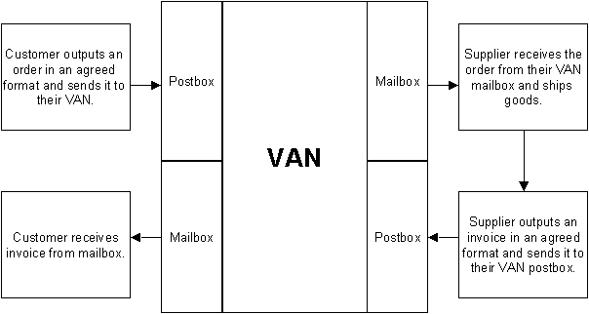
Components of value added network (Mail box)
Users of a VAN (Value Added
Network) can send messages to
and retrieve messages from
a mailbox. This is a specialized
subscriber service that will
hold messages until the
subscriber requests them.
company is assigned a mailbox.
communications adaptor initiates
a connection to that VAN mailbox
and uploads the EDI files to the
VAN mailbox.

Slide 18
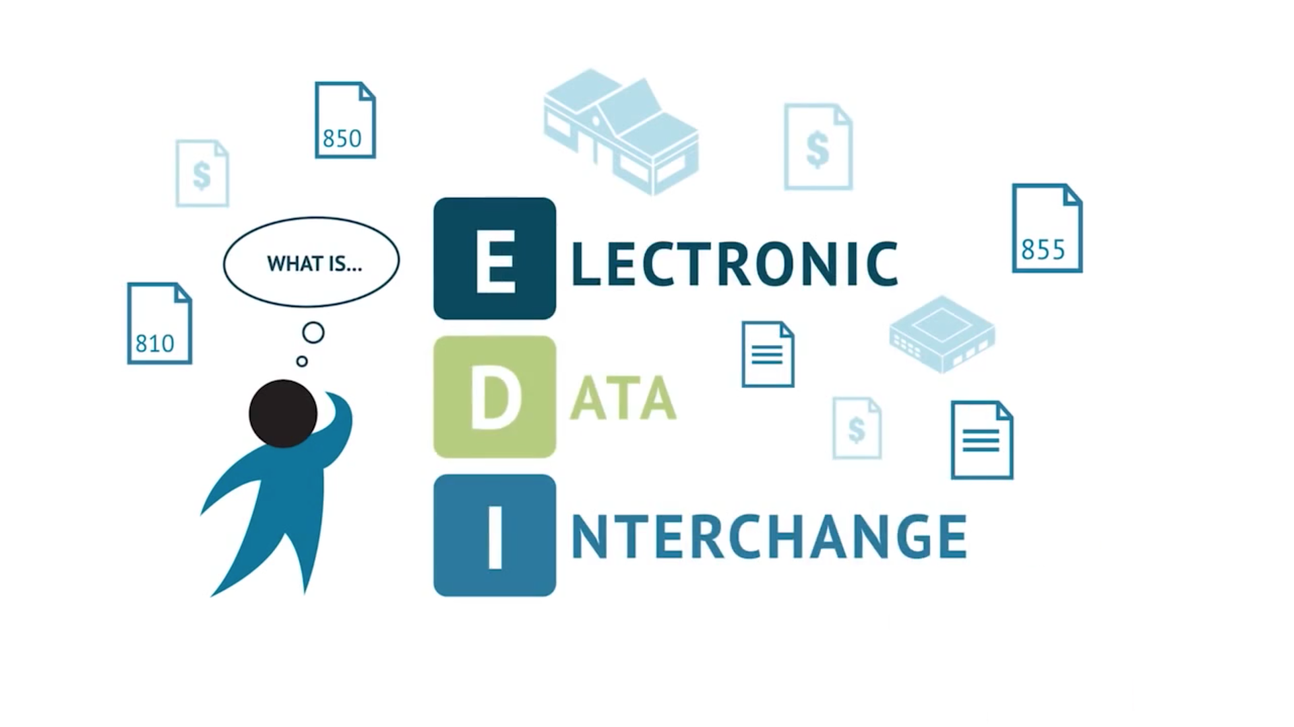
ELECTRONIC DATA INTERCHANGE (EDI)

Slide 19
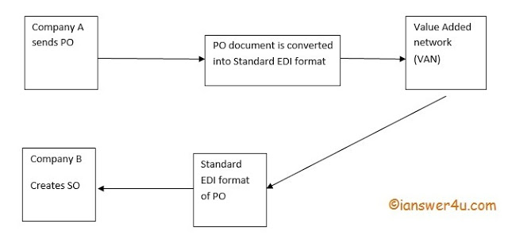
Electronic Data Interchange (EDI) is the electronic interchange of business information using a standardized format; a process which allows one company to send information to another company electronically rather than with paper.
Working of EDI:-

Slide 20
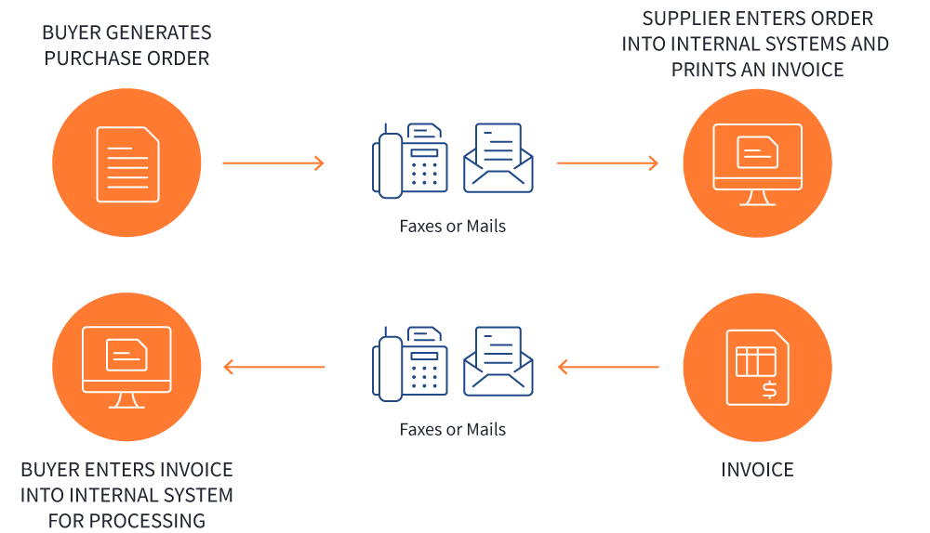
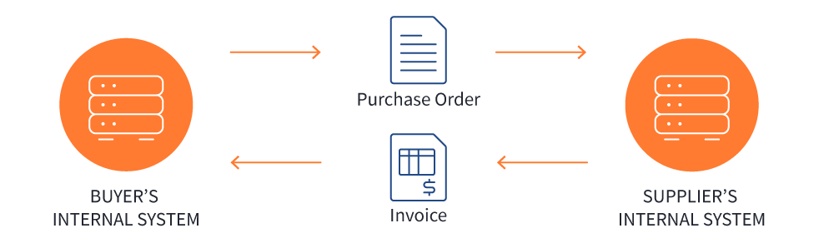
Without EDI process looks like this — paper, different people involved , step to long:-
The EDI process looks like this — no paper, no people involved, step to short:-
These are some of the examples of EDI standard format used by different organizations:-
UN/EDIFACT standard, ANSI ASC X12, GS1 EDI ,TRADACOMS , HL7,etc.

Slide 21

WORKING OF VANs

Slide 22
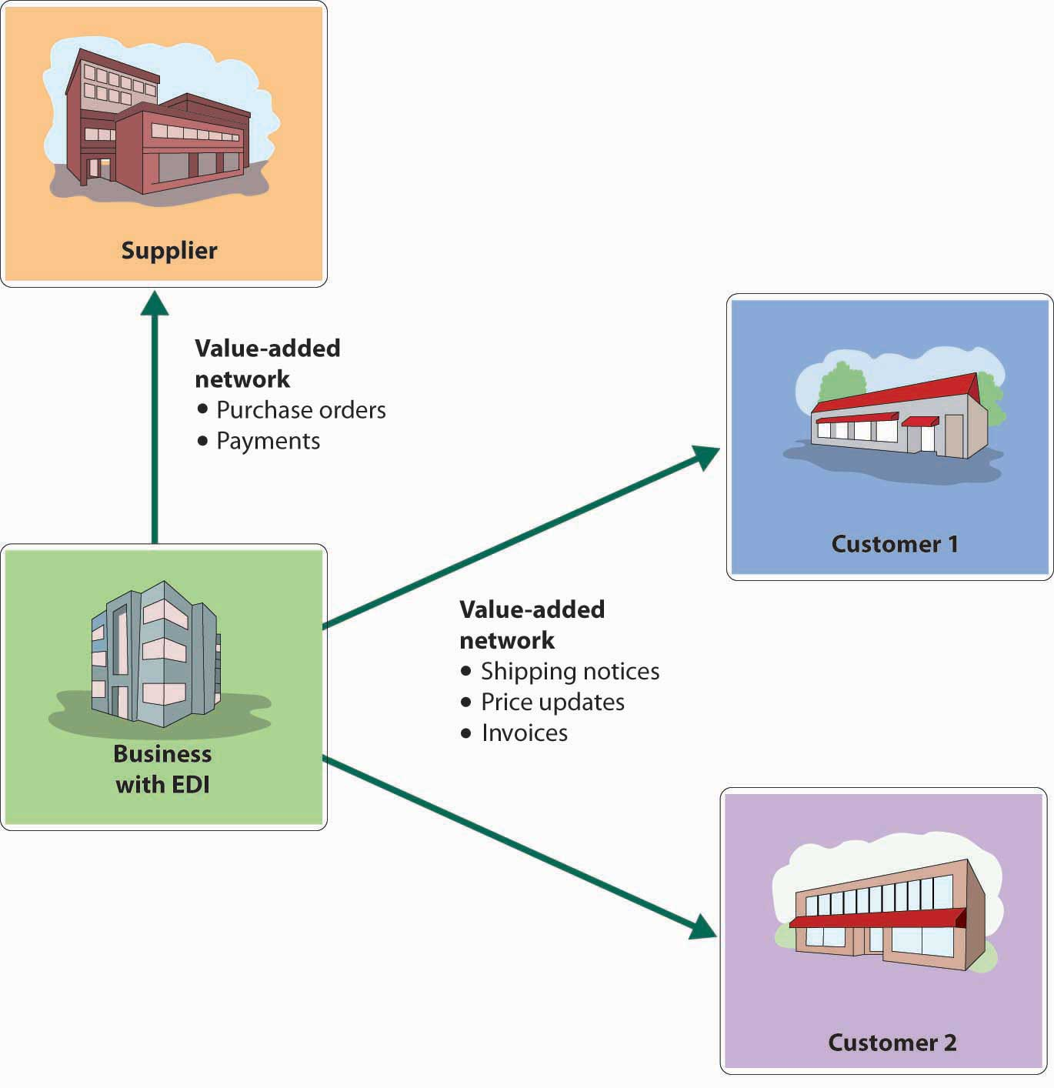
Working of VAN
Value-added networks (VANs) usually operate in a mailbox setting, wherein a company sends a transaction to a VAN, and the VAN places it in the receiver's mailbox. The receiver contacts the VAN and picks up the transaction, and then sends a transaction of its own.
The system is similar to email, except that it is used for standardized structured data rather than unstructured text.

Slide 23

VANs traditionally transmit data formatted as Electronic Data Interchange but increasingly they also transmit data formatted as XML or in more specific “binary” formats. VANs usually service a given industry and provide “Value Added Network Services” such as data transformation between formats (EDI-to-XML, EDI-to-EDI, etc.).
A VAN not only transports (receives, stores and forwards) documents but also adds audit information to them and modifies the data in the process of automatic error detection and correction or conversion between communications protocols.

Slide 24

VAN In Internet ERA

Slide 25
VAN IN INTERNET ERA
The ubiquity of the Internet has lessened the attraction of VANs, largely due to cost considerations. it is often more cost-effective to move data over the Internet than to pay the minimum monthly fees and per-character charges included in typical VAN contracts. VANs have countered the challenge from the internet by focusing on specific industry verticals such as healthcare, retail, and manufacturing. These industries have unique data integrity and security concerns that make VANs a true value-added solution

Slide 26
VANs can also provide visibility tools that show the delivery status of data and some corresponding workflows, allowing companies to better coordinate dependent activities through the system rather than exchanging phone calls and emails. Not only is using a VAN more efficient and more accurate, but it also saves the cost of hiring human data-entry professionals for the exchange of information.
Like many pre-Internet technologies, VANs have had to reinvent themselves to remain relevant going forward. Today, VANs offer services that go above and beyond mailboxes for EDI exchange and retrieval, authentication of messages, and archival of past transactions. Modern VANs create value for businesses by offering automatic backups of EDI data, flexible access to that data via secure web portals, and unlimited data pricing packages

Slide 27
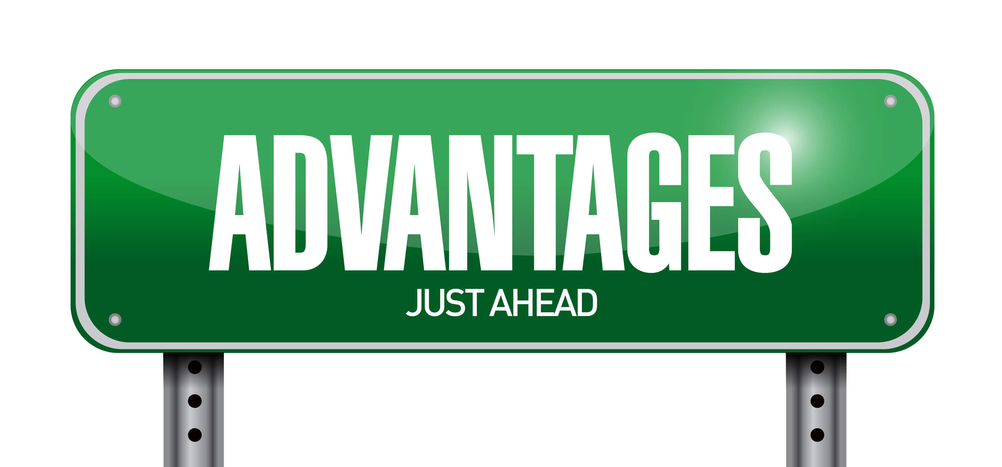

ADVANTAGES OF VAN

Slide 28
1) Error correction:-
VANs help in error correction, as they reduce human involvement, and improve recordkeeping. They can perform checks at the transaction level and ensure minimal error.
2) Improved exchange:-
The exchange of data becomes real-time with VANs. This improves decision-making and record-keeping and provides essential business intelligence to generate insights about operations.

Slide 29
3) Secure:-
Electronic data transfers can be made securely using encryption. All communication between businesses can be encrypted to protect business secrets.
4) Standardized:-
VANs transfer data using standard formats, such as XML and CSV. They allow the data to be read by the various Enterprise Resource Planning (ERP) software used by companies. They also enable the use of newer technologies without making changes to existing technology.

Slide 30

DISADVANTAGES OF VANs

Slide 31

COST AND INSTALLATION
THE ADDED FEATURES AVAILABLE ON A VAN ARE NOT FREE. IN FACT, MANY OF THE MOST SOPHISTICATED VANS CAN BE QUITE EXPENSIVE, CHARGING SUBSCRIPTION COSTS OR DATA- TRANSFER RATES. SETTING UP A VAN IN YOUR E-COMMERCE BUSINESS CAN ALSO BE RATHER COMPLEX AND COSTLY, OFTEN REQUIRING NEW EQUIPMENT OR EMPLOYEE TRAINING AS DATA MANAGEMENT PROCESSES CHANGE. THESE ADDEDA COSTS CAN BE WORTHWHILE FOR SOME BUSINESSES THAT ARE PARTICULARLY CONCERNED WITH DATA SECURITY, YET ARE NOT FOR EVERY E- COMMERCE OPERATION.

Slide 32
THE DOUBLE-EDGED SWORD OF VAN USE
Given the added cost of contracting the service, VAN systems are most often found in larger corporations and e-commerce sites.
A small business with a VAN, therefore, may be able to streamline communication and transactions with the bigger players in the field, a considerable advantage in some sectors, such as e-commerce resellers.
Having a VAN, however, can also make communication more complicated with small players that rely on simpler data-transfer methods. Small businesses are often forced to keep their old systems running after contracting a VAN in order to communicate with some of their smaller partners and affiliates

Slide 33
Uses in Market
E-Commerce
Information Sharing
Online Sales
Logistics

Slide 34
Providers of VAN
Mulesoft
Dell Boomi
SPS Commerce
Your Edi

